Slide 1
Introduction Python
Code Kickstart (Python Programming)
Link Google Colab :
Python Basic https://bit.ly/DBBStudentHandson

Slide 2
Profile
Hello I’m Iqbal Ridalta Putra
I’m currently working as Data Analyst at tech company

Slide 3

Table of Contents : Looping and Pattern
1 | Recall If Else Statement
2 | Looping Basics using For
3 | Looping Basics using For
4 | Infinite and Nested Loops
Outline Kelas

Slide 4

THE IF STATEMENT
The if statement runs lines of indented code when a given logical condition is met
if condition:
Indicates an if statement
A logical expression that evaluates to True or False
Examples:
price > 100
product == ‘skis’
inventory > 0 and inventory <= 10

Slide 5
THE IF STATEMENT
The if statement runs lines of indented code when a given logical condition is met
if condition:
do this
Code to run if the logical expression returns True
(must be indented!)

Slide 6

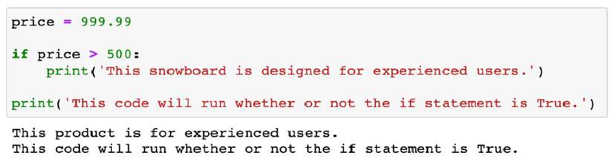
THE IF STATEMENT
The if statement runs lines of indented code when a given logical condition is met
EXAMPLE
Determining experience level for a snowboard
How does this code work?
if
condition
False
True
if code
Rest of code

Slide 7
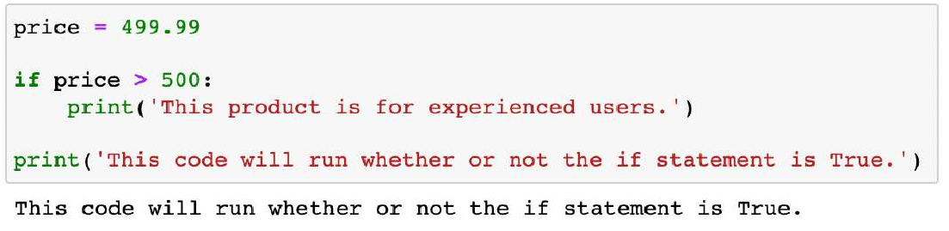
CONTROL FLOW
Control flow is a programming concept that allows you to choose which lines to execute, rather than simply running all the lines from top to bottom
There are three conditional statements that help achieve this: if, else, and elif
EXAMPLE
Determining experience level for a snowboard
Python uses indentation to depart from a linear flow
In this case, the first print statement only runs if price is greater than 500
Press tab, or use four spaces, to indent your code when writing if statements or you will receive an IndentationError

Slide 8

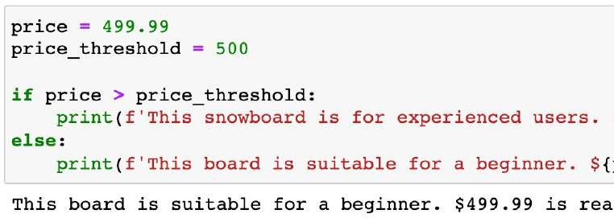

THE ELSE STATEMENT
The else statement runs lines of indented code when the none of the logical conditions in an if or elif statements are met
EXAMPLE
Determining experience level for a snowboard
How does this code work?
if
condition
False
True
if code
else code
Rest of code

Slide 9

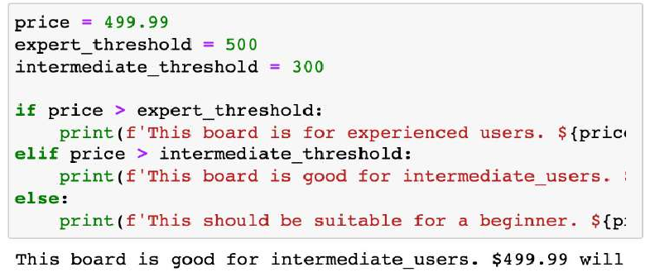
THE ELIF STATEMENT
The elif statement lets you specify additional criteria to evaluate when the logical condition in an if statement is not met
EXAMPLE
Determining experience level for a snowboard
How does this code work?
if
condition
False
True
elif
condition
False
True
if code
elif code
else code
Rest of code

Slide 10
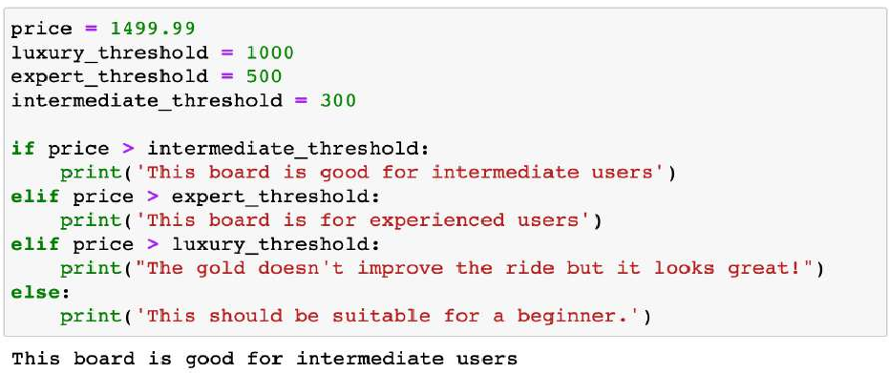
THE ELIF STATEMENT
Any number of elif statements can be used between the if and else statements As more logical statements are added, it’s important to be careful with their order
Will the elifs below ever run?
No, because any value that is true for them will also be true for the if statement above them
Either put the most restrictive conditions first, or be more explicit with your logic

Slide 11

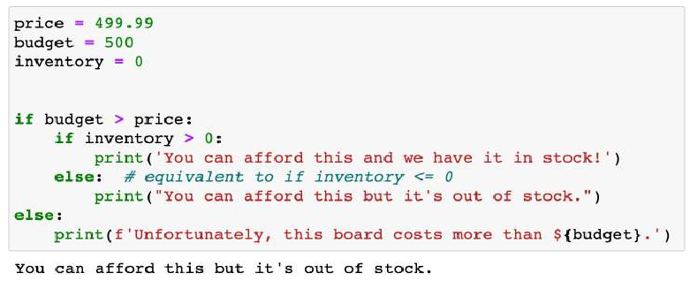
NESTED IF STATEMENTS
Nested if statements let you specify additional criteria to evaluate after a logical condition in an if statement is met
EXAMPLE
Trying to purchase a product
How does this code work?
if
condition
False
True
Nested if
condition
False
True
Nested if code
Nested else code
else code
Rest of code

Slide 12



LOOP BASICS
A loop is a block of code that will repeat until a given condition is met
There are two types of loops:
FOR LOOPS
WHILE LOOPS
Run a specified number of times
“For this many times”
This often corresponds with the length of a list, tuple, or other iterable data type
Should be used when you know how many times the code should run
Run until a logical condition is met
“While this is TRUE”
You usually don’t know how many times this loop will run, which can lead to infinite loop scenarios
(more on that later!)
Should be used when you don’t know how many times the code should run

Slide 13
LOOP BASICS
Why should we learn looping?
🔑 1. Automation of Repetitive Tasks
Without loops: you’d have to copy–paste the same instruction many times.
With loops: one short block of code runs 100 times, 1000 times, or more without effort. 👉 Example: printing numbers 1 to 100 — one loop instead of 100 lines of code.
🔑 2. Works with Data Collections
Real programs deal with lists, files, databases, user inputs.
Loops let you go through each element and process it. 👉 Example: summing all sales in a list, going through all customers in a database.
🔑 3. Scalability
A program with loops works for 10 elements, 1000 elements, or millions — without changing the logic. 👉 That’s why looping is at the heart of data analysis, reporting, and automation.
🔑 4. Saves Time + Fewer Errors
Writing code once and letting the loop handle repetition → less risk of typos, more maintainable code.

Slide 14
FOR LOOPS
A for loop will run a specified number of times
This often corresponds with the length of a list, tuple, or other iterable data type
for item in iterable:
Indicates a For Loop
A variable name for each item in the iterable
Examples:
Price
Product
Customer
Iterable object to loop through
Examples:
List
Tuple
String
Dictionary
Set

Slide 15
FOR LOOPS
A for loop will run a specified number of times
This often corresponds with the length of a list, tuple, or other iterable data type
for item in iterable: do this
Code to run until the loop terminates (must be indented!)
Run order:
item = iterable[0]
item = iterable[1]
item = iterable[2]
•
•
n. item = iterable[len(iterable)-1]

Slide 16
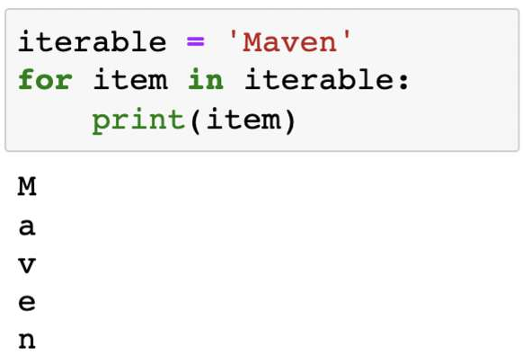

FOR LOOPS
EXAMPLE
Printing individual letters in a string
How does this code work?
Since ‘Maven’ is a string, each letter is an
item we’ll iterate through
iterable = ['M', 'a', 'v', 'e', 'n']
The code will run and print each item in the iterable
item | = | iterable[0]
item | = | iterable[1]
item | = | iterable[2]
item | = | iterable[3]
item | = | iterable[4]

Slide 17
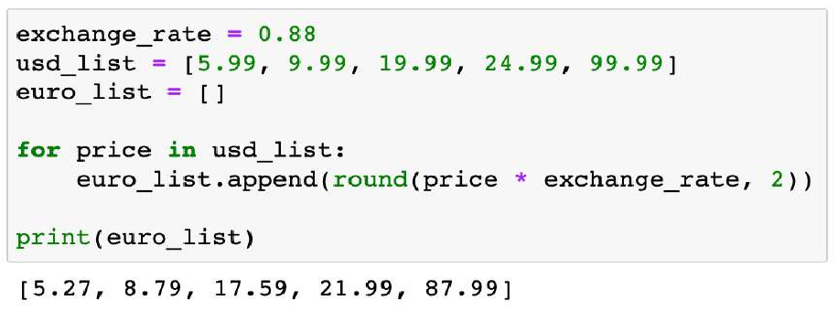

LOOP BASICS
A loop is a block of code that will repeat until a given condition is met
EXAMPLE
Converting elements in a price list from USD to Euros
Now we’re using a For Loop to cycle through each element in the usd_list and convert it to Euros
We only used two lines of code to process the entire list!
Don’t worry if the code looks confusing now (we’ll cover loop syntax shortly), the key takeaway is that we wrote the conversion one time and it was applied until we looped through all the elements in the list

Slide 18
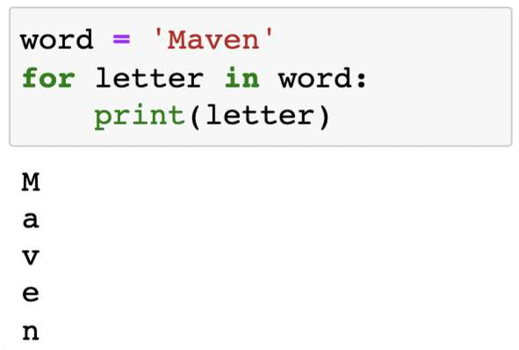


FOR LOOPS
EXAMPLE
Printing individual letters in a string
How does this code work?
Since ‘Maven’ is a string, we’ll iterate through each letter
word = ['M', 'a', 'v', 'e', 'n']
The code will run and print each letter in the word
letter | = | word[0]
letter | = | word[1]
letter | = | word[2]
letter | = | word[3]
letter | = | word[4]
PRO TIP: Give the components of your loop intuitive names so they are easier to understand

Slide 19


LOOPING OVER ITEMS
Looping over items will run through the items of an iterable
The loop will run as many times as there are items in the iterable
The for loop here is looping over the items, (elements) of usd_list, so the loop code block runs 5 times (length of the list):
price = usd_list[0] = 5.99
price = usd_list[1] = 9.99
price = usd_list[2] = 19.99
price = usd_list[3] = 24.99
price = usd_list[4] = 99.99
PRO TIP: To create a new list (or other data type) with loops, first create an empty list, then append values as your loop iterates

Slide 20
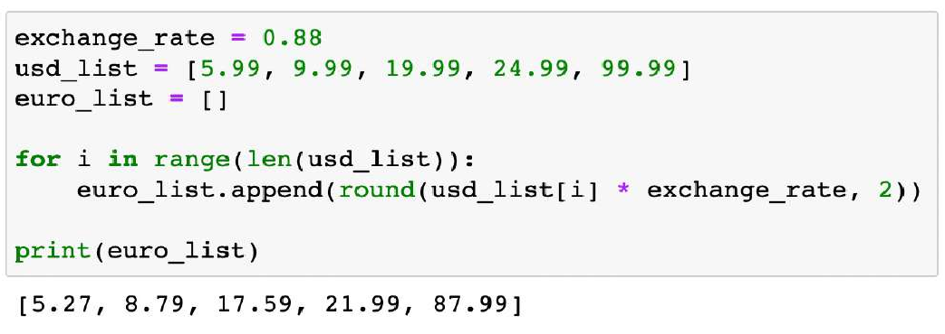
LOOPING OVER INDICES
Looping over indices will run through a range of integers
You need to specify a range (usually the length of an iterable)
This range can be used to navigate the indices of iterable objects
The for loop here is looping over indices in a range the size of the euro_list, meaning that the code will run 5 times (length of the list):
The index is selecting the elements in the list
1. i = 0
2. i = 1
3. i = 2
4. i = 3
5. i = 4
PRO TIP: If you only need to access the elements of a single iterable, it’s a best practice to loop over items instead of indices

Slide 21
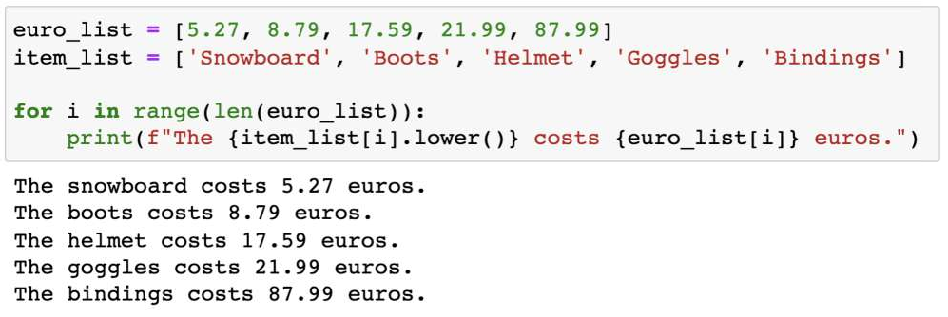
LOOPING OVER MULTIPLE ITERABLES
Looping over indices can help with looping over multiple iterables, allowing
you to use the same index for items you want to process together
EXAMPLE
Printing the price for each inventory item
The for loop here is looping over indices in a range the size of the euro_list, meaning that the code will run 5 times (length of the list)
For the first run:
i = 0
item_list[i] = Snowboard
euro_list[i] = 5.27

Slide 22


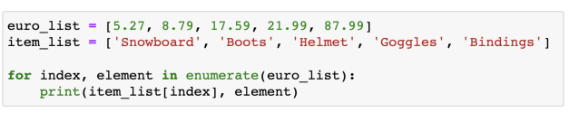
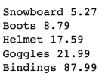
PRO TIP: ENUMERATE
The enumerate function will return both the index and item of each item in an iterable as it loops through
PRO TIP: Use enumerate if you want to loop over an index; it is slightly more efficient and considered best practice, as we are looping over an index derived from the list itself, rather than generating a new object to do so.
Use the index for multiple lists!
We’re using the index of the euro_list to access each element from the item_list, and then printing each element of the euro_list

Slide 23
WHILE LOOPS
While loops run until a given logical expression becomes FALSE
In other words, the loop runs while the expression is TRUE
while logical expression:
Indicates a While Loop
A logical expression that evaluates to TRUE or FALSE
Examples:
counter < 10
inventory > 0
revenue > cost

Slide 24
WHILE LOOPS
While loops run until a given logical expression returns FALSE
In other words, the loop runs while the expression is TRUE
while logical expression: do this
Code to run while the logical expression is TRUE (must be indented!)

Slide 25
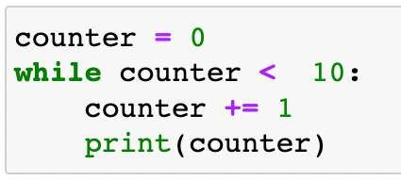

WHILE LOOPS
While loops often include counters that grow with each iteration
Counters help us track how many times our loop has run
They can also serve as a backup condition to exit a loop early (more on this later!)
This is an “addition assignment”, which adds a given number to the existing value of a variable:
counter = counter + 1
1
2
.
.
10
Counter increases to 1 in the first iteration Counter increases to 2 in the second iteration
When the counter increments to 10, our condition becomes False, and exits the loop

Slide 26
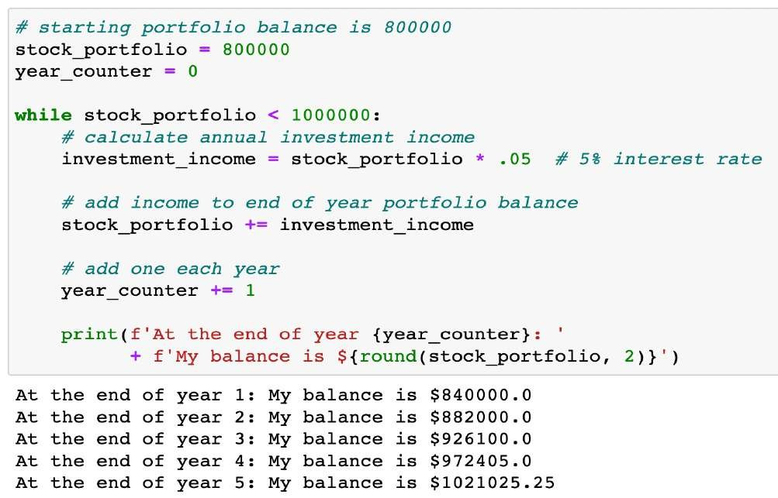
WHILE LOOPS
EXAMPLE
Run a calculation until a goal is reached
The while loop here will run while stock_portfolio is less than 1m
stock_portfolio starts at 800k and
increases by 5% of its value in each run:
800k < 1m is TRUE
840k < 1m is TRUE
882k < 1m is TRUE
926k < 1m is TRUE
972k < 1m is TRUE
1.02m < 1m is FALSE (exit)

Slide 27
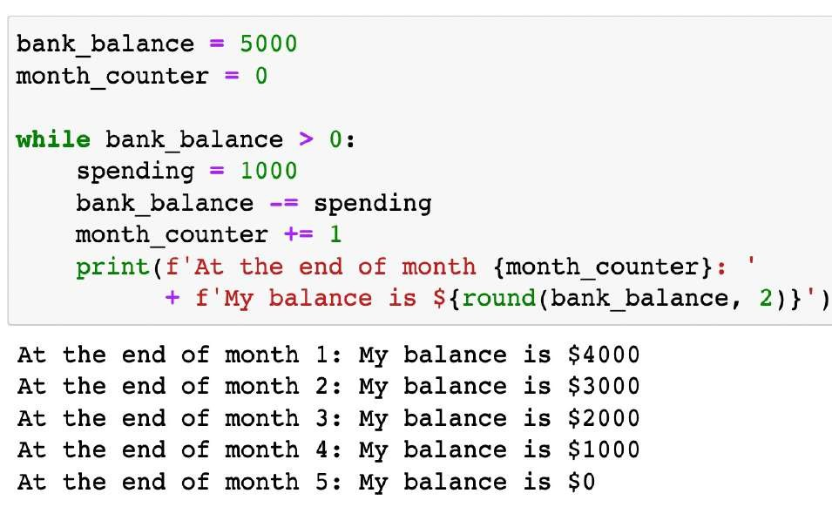



WHILE LOOPS
EXAMPLE
Calculating bank balance until we’re out of money.
PRO TIP: Use “-=” to subtract a number from a variable instead (subtraction assignment)

Slide 28
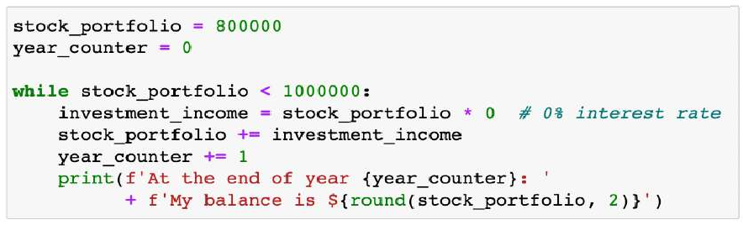
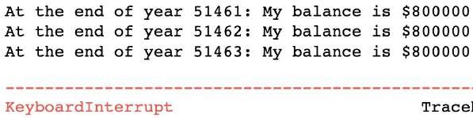

INFINITE LOOPS
A while loop that always meets its logical condition is known as an infinite loop
These can be caused by incorrect logic or uncertainty in the task being solved
The while loop here will run while stock_portfolio is less than 1m, which will always be the case, as it’s not growing due to 0% interest
If your program is stuck in an infinite loop, you will need to manually stop it and modify your logic
This indicates a manually stopped execution

Slide 29

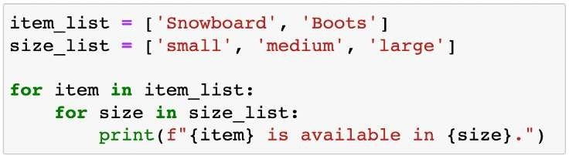
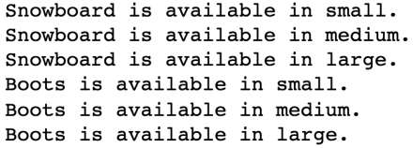
NESTED LOOPS
Loops can be nested within another loop
The nested loop is referred to as an inner loop (the other is an outer loop)
These are often used for navigating nested lists and similar data structures
EXAMPLE
Printing items along with their sizes
How does this code work?
The inner loop (size_list) will run completely for each iteration of the outer loop (item_list)
In this case, the inner loop iterated three times for each of the two iterations of the outer loop, for a total of six print statements
NOTE: There is no limit to how many layers of nested loops can occur
item_list[0], size_list[0] item_list[0], size_list[1] item_list[0], size_list[2] item_list[1], size_list[0] item_list[1], size_list[1] item_list[1], size_list[2]

Slide 30
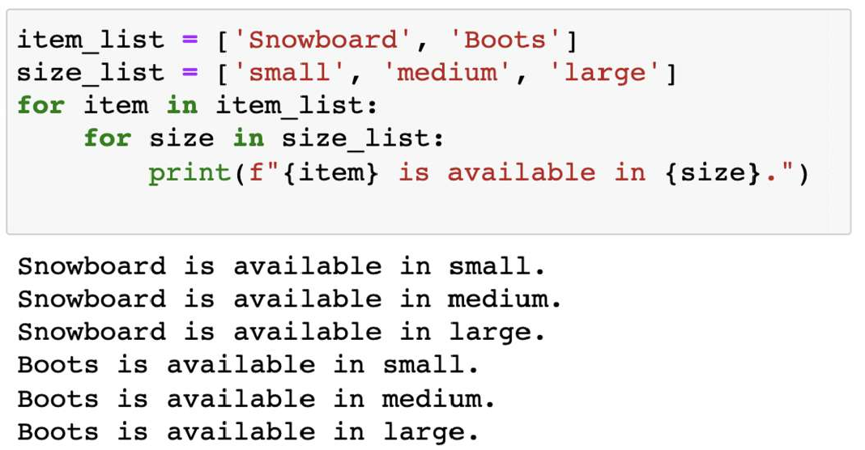
NESTED LOOPS
EXAMPLE
Printing items along with their sizes

Slide 31
Thanks

